Slide 1

IT1768 - Database Systems
Topic 2 :
Database Models and Relational Keys
click hyperlink below:
Reference source: https://www.youtube.com/watch?v=t8jgX1f8kc4

Slide 2
Unit 2 : Relational Database & Keys
Objective :
At the end of this unit, you should be able to:
  relate different database models.
  describe the common terminology used in relational database.
  describe various essential relation keys in relational model.
  classify various database objects and their functions.

Slide 3
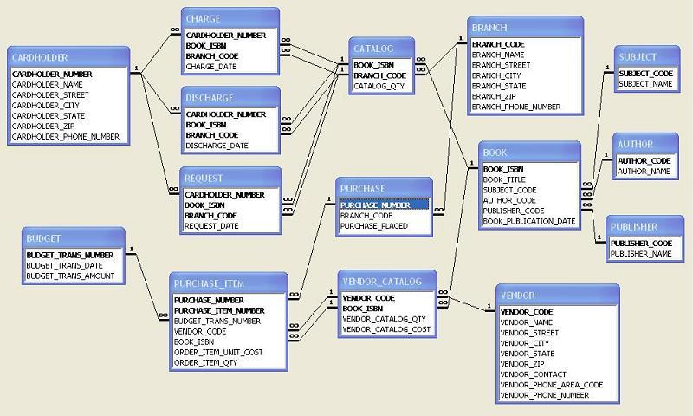
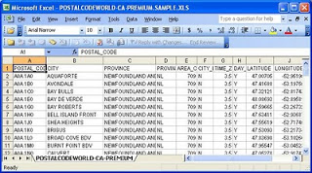
Database – a collection of tables
Database
Tables are associated with relationships!
Table 1
Table 2 …

Slide 4
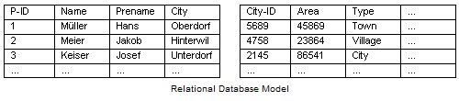
The Relational Model
Relational database is the most common type of database system employed in most enterprises.
Relational data model : Relational database deals predominantly with relational database model.
Relational model uses a table-based format with rows and columns.
Relation 1
Relation 2
Columns
Rows

Slide 5
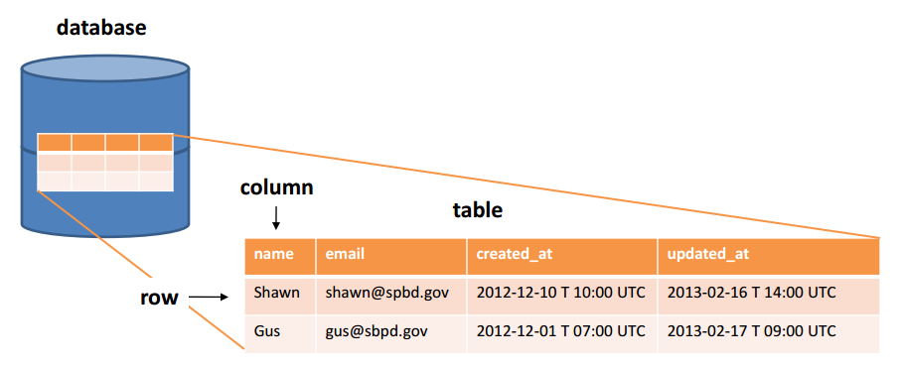
The Relational Database
Relational model – tables, represented by rows and columns.
row
There are multiple tables contained in a relational database.

Slide 6
Terminology
Equivalent Terminology
Relational Model | Entity Relationship | SQL Equivalent (File)
Relation | Entity | Table
Tuple | Record | Row
Attribute | Field | Column
(Relation : CUSTOMERS)
(Attribute)
(Entity)
(Field)
CUSTOMERS
(Column)
(Table)
ID | Name | Country | Age
1403-001 | James Bond | UK | 45
1403-126 | Judy Emily | Indonesians | 30
1403-389 | Jennifer | USA | 32
(Tuple)
(Record)
(Row)

Slide 7
Relational Model
- Tables
1) Table (Entity) (Relation) name: CUSTOMER
(Column)
(Field)
(Attribute)
CustomerID | CustName | Country | Age
1403-001 | James | UK | 45
1403-126 | June | Aus | 26
1403-389 | Jennifer | USA | 32
(Table)
(Row)
(Entity)
(Record)
(Relation)
(Tuple)
Equivalent Terminology
SQL Equivalent | Entity Relationship | Relational Model
Table | Entity | Relation
Row | Record | Tuple
Column | Field | Attribute

Slide 8
Relational Model Terminology
- Self test
(Relation / Entity / Table) name: CUSTOMERS
CustID | CompName | Country | Phone | Person
SW26 | Unions Supplies | Sweden | 02-12-38-456 | Morgan
Ger30 | Worlds Logistics | Germany | 00-12-34-135 | Smith
Kor56 | Best Enterprises | Korean | 02-32-31-532 | Kim
USA45 | Sunrise Finance | USA | 12-27-82-234 | Obama
(Tuple) / (Record) /
(Row)
(Attribute) / Field / Column
(e.g. Field name : Country)
1) Name of table / entity / relation:
2) Number of row / record / tuples:
3) Number of column / field / attribute:
4) List one field name :
5) List one row / record with CustID: ‘Ger30’ :
6) List a value of column / field /attribute ‘Country’ :
7) List an entity instance with CustID: ‘USA45’ :
8) List an attribute instance of ‘Person’
CUSTOMERS
4
5
Country
Ger30, Worlds …Germany..1345.. .Smith
Germany
USA45, Sunrise..USA..12..-234..Obama
Smith

Slide 9
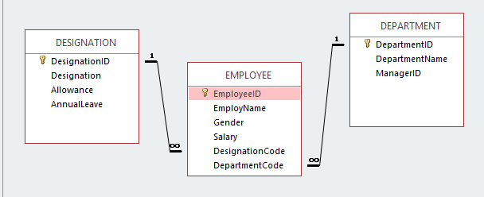
Relations and Relationship
A relation / (entity/ table) is an identifiable object (a person, a place, a thing, or an event) about which data are to be collected and stored.
In Relational model, relationships existed between relations.
Relationship linked the common attributes (fields / columns) in two adjacent relations (entities / tables).
Relationships
Attribute name
Relation
EMPLOYEE (EmployeeID, EmployeeName, Gender, Salary, DesignationCode, DepartmentCode)

Slide 10
Presentation of Relations (Entities)
Different ways of display a relation:
EMPLOYEES
EMPLOYEES
EmpID
EMPLOYEES
EmpID
EmpName
Gender
DepNo
1
A relation with no attribute
2
A relation showing only one key attribute
3
A relation showing all attributes
EmpID
DepNo
EmpName
EMPLOYEES
Gender
4
A relation with attributes by Chen’s Notation

Slide 11
Relational Model - Attributes
2) Attributes
Relation: EMPLOYEES
EMPLOYEES
EmpID
EmpName
Gender
DepNo
Attributes describe the relation itself.
e.g. : EMPLOYEE relation class has the following attributes :
  EmpID
  EmpName
  Gender
  DepNo
EmpID | EmpName | Gender | DepNo
E-18 | Chris | Male | Dep-02
E-28 | Joyce | Female | Dep-05
E-33 | Steve | Male
For every attribute
(e.g. EmpName), it shall contain a:
Field name
Field length =
Data type
together, they form the domain of the attribute.
domain

Slide 12
Relational Model Terminology
- Self test
Domain
Relation name: PROJECT
Field name
Field length
Data type
ProjectID | ProjectName | DateStart | Budget | Duration (yr)
UM-38 | Unity Malls | 20-Oct-2012 | $6.800,000 | 2.25
HB-54 | HillGate Bridge | 18-Nov-2012 | $8,650.000 | 1.75
PT-27 | Port Tower | 16-Mar-2013 | $25,820.000 | 2.50
SL-68 | Sunrise Lodge | 25-May-2014 | $560.000.000 | 3.25
Description
9) Data type of attribute ProjectID:
10) Data type of attribute DateStart:
11) Data type of attribute Budget :
12) Data type of attribute Duration :
13) Field length of attribute ProjectID :
14 Field length of attribute DateStart :
15) Domain of attribute Budget :
Terminology
text
date
currency
decimal
8 | Note: Maxi length is 8 though it uses 5 in the example
13 | Note: Maxi length is 13 though it uses 11 in the example
Field name: Budget, Field length: 12, Data type : currency

Slide 13

Relational Keys
George Bush (Head)
George Bush
Mrs Bush
Marvin Bush
Jeb Bush
Neil Bush
Lucy Bush
Child-Neil Bush
Child-Marvin Bush
FamilyHead | Wife | Kid1 | Kid2 | Kid3
Gorge Bush | Lucy | Marvin | Jeb | Neil
Child-Jeb Bush
If you know George Bush, you can identify his family members.
It is because George Bush is the identifier of the family !
How about identifying data in a tuple (row) ?

Slide 14
Relational Keys - Primary Key
An identifier (or key) is unique and it can identify the entire tuple (record/row). This identifier is the Primary key of the relation.
CUSTOMERS
NRICNo | CustName | Gender | Age | Address
S8532567G | Esther Lim | Female | 27 | Blk 20, #12-30, AMK Ave 5
S9023456J | Judy Tan | Female | 22 | Blk 8, #10-98, AMK Ave 8
S8230983K | James Koh | Male | 30 | Blk 180, #03-52, AMK Ave 10
Every ‘NRICNo’ from the table can identify a row (record/tuple).
By knowing “S8230983K”, it can identify that the custName is “James Koh”, a male of age 30, address @ Blk 180 …
‘NRICNo’ being the identifier (i.e. Primary key) of the table.

Slide 15
Relational Model – Primary & Foreign Keys
DOCTOR
(relationship)
PATIENT
(Primary key)
DoctorID
DoctorName
Discipline
Location
PatientID
PatientName
Clinic
DoctorNo
treat
(Foreign key)
(Parent entity)
(Child entity)
In DOCTOR relation, DoctorID is the Primary key. It links to DoctorNo in the PATIENT relation.
DoctorNo in the PATIENT relation being the Foreign Key.
Primary and Foreign Keys are linked by a relationship.

Slide 16
Relational Model : PK, FK & Relationship
(Parent table)
DOCTOR
‘DoctorID’ from DOCTOR relation / table is a primary key
DoctorID | DoctorName | Discipline | Location
DOC-SL | Sam Lim | Cardiology | ME Hospital
DOC-HY | Henry Yeo | Cardiology | NS Hospital
DOC-JS | John Samy | Paediatric | JC Hospital
DOC-SA | Susan Amal | Radiology | NS Hospital
DOC-MK | Mohd Kassim | Radiology | SG Hospital
(PK)
(Relationship)
(FK)
‘DoctorNo’ from PATIENT relation / table is a foreign key
PATIENT
PatientID | PatientName | Clinic | DoctorNo
PAT-31 | Michael | Paediatric | DOC-JS
PAT-52 | Jennifer | Cardiology | DOC-HY
PAT-79 | Steven | Radiology | DOC-SA
PAT-80 | Susan | Radiology | DOC-SA
(Child table)

Slide 17
Foreign Key (FK)
A Foreign Key (FK) is an attribute of one relation whose values are required to match those of the primary key of another relation.
DOCTOR
(Parent table)
DoctorID
DoctorID | DoctorName | Discipline | Location
DOC-SL | Sam Lim | Cardiology | ME Hospital
DOC-HY | Henry Yeo | Cardiology | NS Hospital
DOC-JS | John Samy | Paediatric | JC Hospital
DOC-SA | Susan Amal | Radiology | NS Hospital
DOC-MK | Mohd Kassim | Radiology | SG Hospital
(FK values match to PK values)
(PK)
PATIENT
(Child table)
(FK)
PatientID | PatientName | Clinic | DoctorNo
PAT-31 | Michael | Paediatric | DOC-JS
PAT-52 | Jennifer | Cardiology | DOC-HY
PAT-79 | Steven | Radiology | DOC-SA
DoctorNo

Slide 18
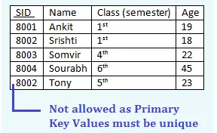
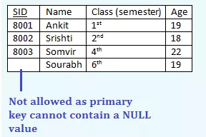
Relational Key – Primary Key (PK)
Characteristics of a Primary Key (PK):
PK has a unique value for each row.
PK can uniquely identify all rows in a table.
In PK, it cannot contain duplicated value.
In PK, it cannot contain null value.
  (Entity Integrity Constraint)
Primary key is a unique key.

Slide 19
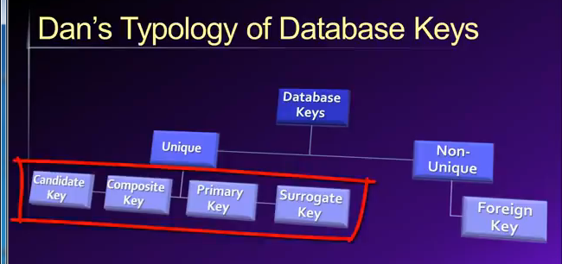
Relational Key – Primary Key (PK)
Primary key is a unique key.
Other unique keys include:
  Candidate keys
  Composite keys
  Surrogate key

Slide 20
Relational Model – Candidate Key
In a relation, a Candidate key is a minimal set of attributes that can uniquely identify each tuple in a relation.
Candidate key can consist of a single attribute or multiple attributes. Multiple attribute keys are known as Composite keys.
One candidate key is designated as Primary key.
ProductID | Items | SupplierNo | Stock
311 | Apple 6 | SS-AP6 | 150
311 | Apple 6 | TT-GS6 | 130
312 | Samsung Galaxy S6 | TT-GS6 | 120
313 | Sony Xperia C3 | SS-XC3 | 90
Relation : MOBILE
  ‘ProductID’ , ‘SupplierNo’ are Candidate keys.
  ‘ProductID’ can possibly be the Primary key for “PRODUCT” relation.
  ‘SupplierNo’ can possibly be the Primary key for “SUPPLIER” relation.

Slide 21
Relational Model – Candidate & Composite Keys
ORDER_DETAIL
ITEM
Candidate Key
OrderNo | ItemNo | Quantity | Date
17Mar10265 | PT-333 | 200 | 20/4
17Mar10265 | CQ-555 | 500 | 22/4
ItemNo | Items | UPrice
PT-333 | Plug-A | $30
CQ-555 | Cable-3m | $20
  (OrderNo, ItemNo) – is the Candidate keys in ORDER_DETAIL relation
In ORDER_DETAIL relation, the same OrderNo can appear in multiple tuples but it pairs with different items. Hence, it is necessary to consider (OrderNo, ItemNo) in the ORDER_DETAIL relation to identify a specific tuple.
  ItemNo in the ITEM relation can be designated as the Primary key because it can uniquely identify a tuple in the relation. However, for the case of ORDER_DETAIL relation. (OrderNo, ItemNo) must be designated as composite keys to identify the tuples.

Slide 22
Relational Model – Composite Key
A Composite key is a key that is composed of two or more attributes needed to identify the tuple.
FLIGHT
FlightNo | FlightDate | FlightTime | From | To | NoOfPassenger
Tiger2901 | 10-Mar-2015 | 0700 | Singapore | Hong Kong | 100
Tiger2901 | 10-Mar-2015 | 1500 | Singapore | Hong Kong | 150
Tiger2901 | 10-Mar-2015 | 2300 | Singapore | Hong Kong | 80
Tiger2901 | 11-Mar-2015 | 0800 | Singapore | Japan | 160
  By ‘FlightNo’ alone, it is NOT unique enough to identify a particular flight detail.
  By combining ‘FlightNo’, ‘FlightDate’ and ‘FlightTime’, the flight records are distinctive.
  ‘FlightNo’ + ‘FlightDate’ + ‘FlightTime’ = Unique !
  Composite key is (FlightNo, FlightDate, FlightTime)

Slide 23
Relational Model – Surrogate Key
In the example below, composite key (FlightNo, DateFlight) can uniquely identify all tuples.
Instead, it can be represented by a Surrogate key.
A Surrogate key in a database is a unique identifier for either an relation in the modelled database.
FLIGHT
OverallID | FlightNo | FlightDate | FlightTime | From | To | NoOfPassenger
1 | Tiger2901 | 10-Mar-2015 | 0700 | Singapore | Hong Kong | 100
2 | Tiger2901 | 10-Mar-2015 | 1500 | Singapore | Hong Kong | 150
3 | Tiger2901 | 10-Mar-2015 | 2300 | Singapore | Hong Kong | 80
  ‘OverallID’ is a Surrogated key. It uniquely identify all tuples in the relation.
The Surrogated key is not derived from application data.

Slide 24
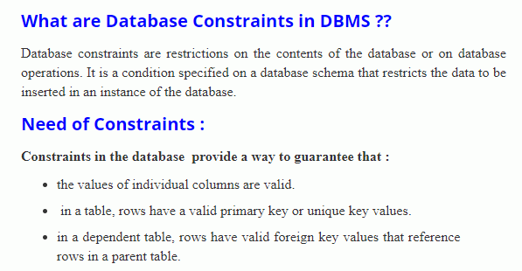
Relational keys and Relational Constraints
Source: http://www.edugrabs.com/types-of-constraints-in-dbms-or-relational-constraints/
Relational constraints are associated with Relational keys in the relations
Constraints are mostly domain related - Referential Integrity Constraint & Entity Integrity Constraint

Slide 25
Referential Integrity Constraint – The violation
1) Referential Integrity Constraint - Definition:
- For any value existed in the foreign key attribute of the child relation, the corresponding value must exist in the primary key attribute of the parent relation.
DOCTOR
(Parent table)
(PK)
DoctorID | DoctorName | Discipline | Location
DOC-11 | Sam Lim | Cardiology | ME Hospital
DOC-22 | Henry Yeo | Cardiology | NS Hospital
DOC-33 | Mohd Kassim | Radiology | SG Hospital
(FK values match to PK values ??)
PATIENT
(Child table)
PatientID | PatientName | Clinic | DoctorNo
PAT-31 | Michael | Paediatric | DOC-11
PAT-52 | Jennifer | Cardiology | DOC-22
PAT-79 | Steven | Radiology | DOC-33
PAT-60 | Tom | EAT | DOC-XA
DoctorNo
(FK)

Slide 26
Referential Integrity Constraint
1) Referential Integrity Constraint - Definition:
- For any value existed in the foreign key attribute of the child relation, the corresponding value must exist in the primary key attribute of the parent relation.
Referential Integrity constraint established between the primary and foreign keys relationships.
  For insertion, the tuple in the Parent relation must be created first before establishing the corresponding tuple in the child relation.
  For deletion, the tuple in the Child relation should be deleted first before deleting the corresponding tuple in the parent relation.

Slide 27
Referential Integrity Constraint
  For insertion, the tuple in the Parent relation must be created first before establishing the corresponding tuple in the child relation.
DOCTOR
(Parent table)
DoctorID
DoctorID | DoctorName | Discipline | Location
DOC-SL | Sam Lim | Cardiology | ME Hospital
DOC-HY | Henry Yeo | Cardiology | NS Hospital
DOC-JS | John Samy | Paediatric | JC Hospital
DOC-SA | Susan Amal | Radiology | NS Hospital
DOC-MK | Mohd Kassim | Radiology | SG Hospital
(PK)
DOC-ZZ | Peter | Radiology | SG Hospital
PATIENT
(Child table)
(FK)
PatientID | PatientName | Clinic | DoctorNo
PAT-31 | Michael | Paediatric | DOC-JS
PAT-52 | Jennifer | Cardiology | DOC-HY
PAT-79 | Steven | Radiology | DOC-SA
DoctorNo
PAT-19 | Matthew | Radiology | DOC-ZZ

Slide 28
Referential Integrity Constraint
  For deletion, the tuple in the Child relation should be deleted first before deleting the corresponding tuple in the parent relation.
DOCTOR
(Parent table)
DoctorID
DoctorID | DoctorName | Discipline | Location
DOC-SL | Sam Lim | Cardiology | ME Hospital
DOC-HY | Henry Yeo | Cardiology | NS Hospital
DOC-JS | John Samy | Paediatric | JC Hospital
DOC-SA | Susan Amal | Radiology | NS Hospital
DOC-MK | Mohd Kassim | Radiology | SG Hospital
(PK)
PATIENT
(Child table)
(FK)
PatientID | PatientName | Clinic | DoctorNo
PAT-31 | Michael | Paediatric | DOC-JS
PAT-52 | Jennifer | Cardiology | DOC-HY
PAT-79 | Steven | Radiology | DOC-SA
DoctorNo

Slide 29

Other Relational Constraints
Entities Integrity Constraint , it entails constraints for primary key such as:
  Each Primary key within a table has a unique value.
  Primary key cannot have null value.
  Primary key cannot have duplicated values in different rows.
NRIC_Num | NAME | GENDER
T0000123A | James | Male
T0000123A | Judy | Female
 | Christopher | Male

Slide 30
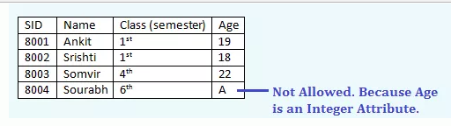
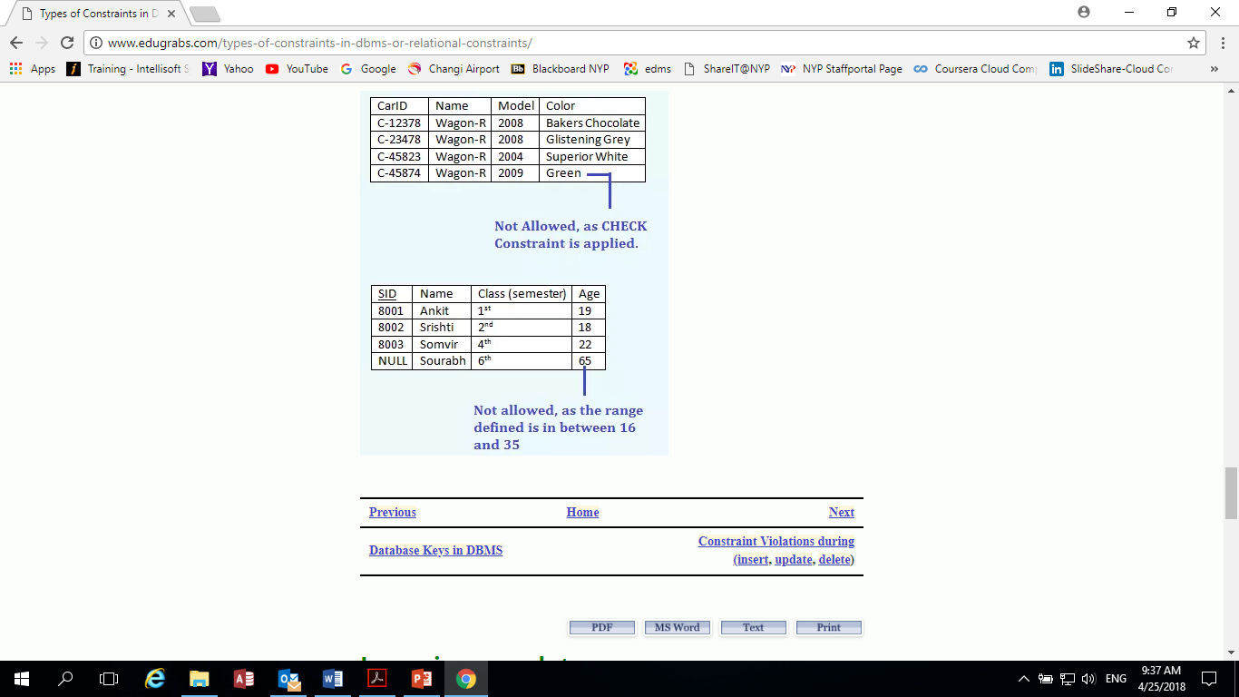
Other Relational Constraints
  User-defined constraint
  A user-defined constraint defined a set of values (for field name, field length or data type) permitted for an attribute.
  For example, a domain of age to be set as a whole number between 16 and 35. A domain of deposit in a bank account is set to accept positive numbers only (e.g. cannot accept entry of -$10).

Slide 31
Different Types of database models
Database systems can be based on different (data) database models. A database model is a collection of concepts and rules for the description of the database structure;
i.e. the data types, the constraints and the relationships for the description or storage of data. (data- stored, organized, manipulated).
The Commonly Used Database Models include:
Hierarchical database model
Network model
Relational model
Object-Oriented model
Entity-Relationship model
Others
→ Model and produce a relational database
Reference source: https://www.lucidchart.com/pages/database-diagram/database-models
Reference video: https://www.youtube.com/watch?v=FR4QIeZaPeM

Slide 32
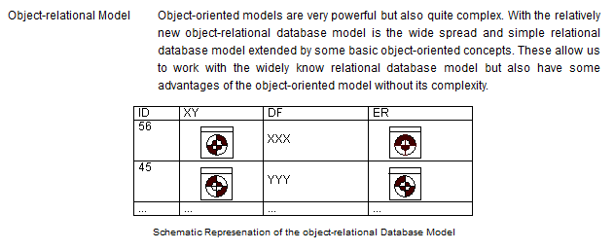
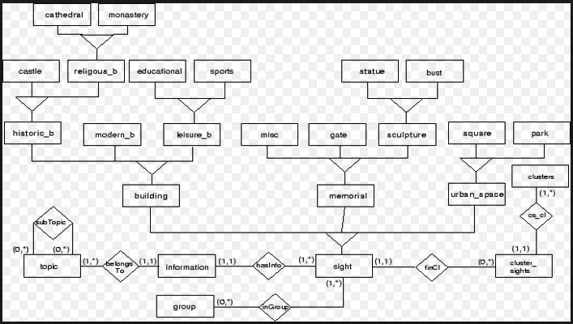
Database Models
- Object-Relational Model
similar to a relational database, but with an object-oriented database model: objects, classes

Slide 33
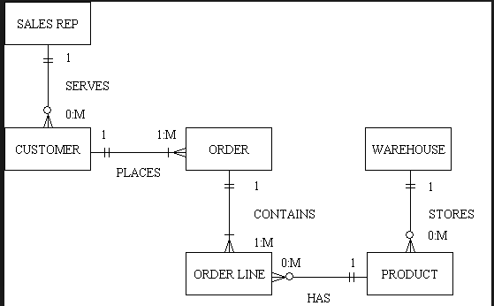
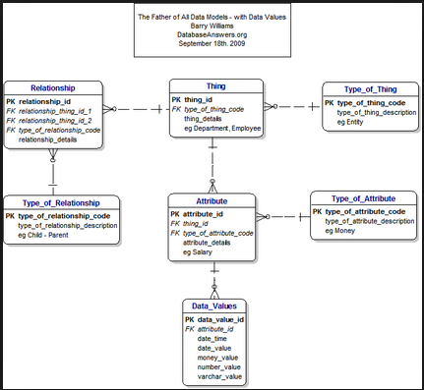
Database Models
- Entity-Relationship Model
Another commonly used database model

Slide 34
Review Question
- Relational database
ProductID | ProductName | UnitPrice | Supplier | DateIn
HWP-10 | Smart Phone HW | $1,148 | Hang Wei | 15-Apr
SSP-9E | Smart Phone SS | $1,268 | JinSung | 15-Apr
Batt-36 | Battery SS | $128 | JinSung | 18-Apr
CHG-45 | Charger S45 | $108 | Hang Wei | 20-Apr
Table: PRODUCT
 | Questions | Answer
1 | Number of rows
2 | Number of columns
3 | One column name
4 | Field length (size) of ‘ProductName’
5 | Data type/field length of ‘Supplier’
6 | Domain of ‘ProductID’
7 | One record of “PRODUCT”
4
5
ProductName
50
Varchar2(30)
Field name:ProductID, Field size: 6, Data type: Text
Batt-36 | Battery SS | $128 | JinSung | 18-Apr

Slide 35
Review Question
- Relational database
ProductID | ProductName | UnitPrice | Supplier | DateIn
HWP-10 | Smart Phone HW | $1,148 | Hang_Wei | 15-Apr
SSP-9E | Smart Phone SS | $1,268 | Jin_Sung | 15-Apr
Batt-36 | Battery SS | $128 | Jin_Sung | 18-Apr
CHG-45 | Charger S45 | $108 | Hang_Wei | 20-Apr
Table: PRODUCT
Foreign Key :
(FK)
Primary Key :
(Relationship)
(PK)
Table: SUPPLIER
SupplierName | SuppAddr | Country | Contact
AMD-chip | 8, Woodlane Ave 2 | Singapore | James
Hang_Wei | 1, West Lake, Hangzhou | PRC | Xu Pin
Jin_Sung | 5, Kim Ji Road, Fushan | Korean | Kim En
Yu_Polymer | 6, Jalan Pemjuru | Singapore | Joseph

Slide 36
Review Question
- Relational Keys
STUDENT( AdminNo, Name, Age, Gender, Course)
Answer for Relational Key
Candidate key
Primary key
WITHDRAWAL( ATMNo, Location, Date, Time, Amount, User)
Answer for Relational Key
Candidate keys
Composite keys
RESULT( ANumber, AdminNo, ModuleID, Score)
Answer for Relational Key
ANumber | AdminNo | ModuleID | Score
R1 | 181111A | IT1761 | 75
R2 | 181111A | IT1768 | 82
R3 | 182222B | IT1761 | 90
R4 | 182222B | IT1768 | 68
Surrogate key

Slide 37
End of Topic 2

